Slide 1
Group 3: Order Fulfillment
Adam.V, Berenice.P, Soham.D, Timothy.C

Slide 2
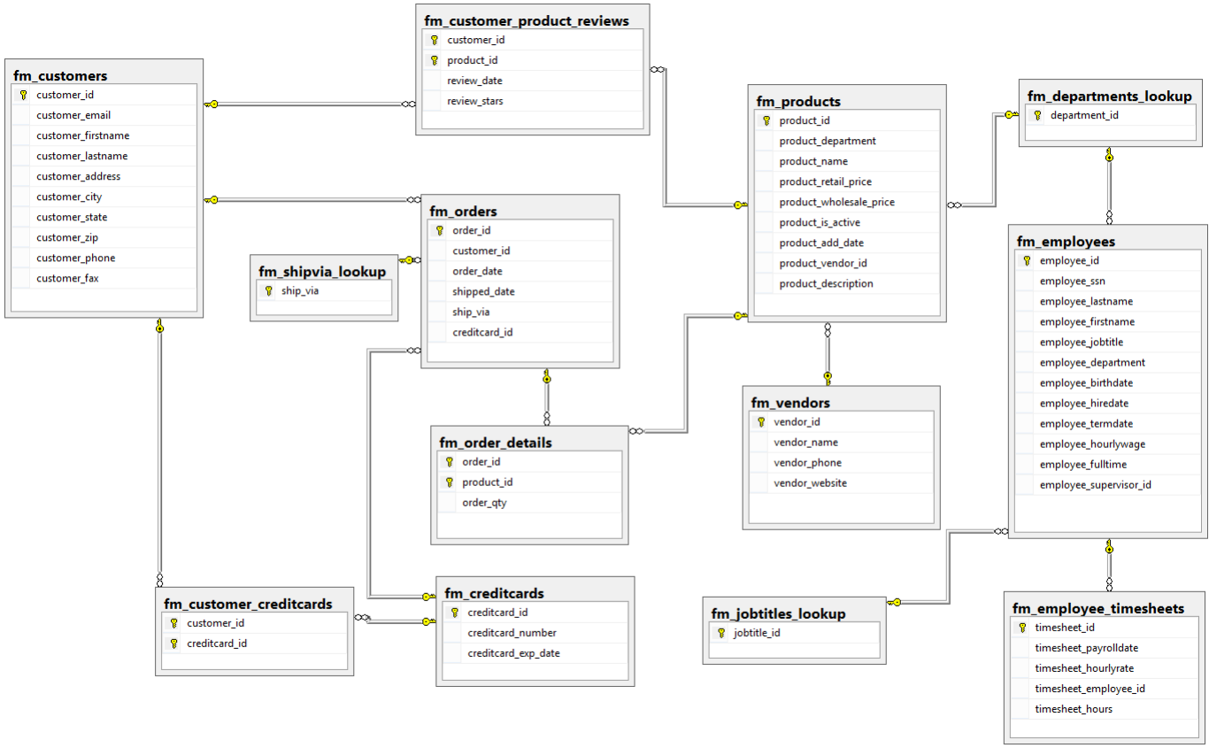
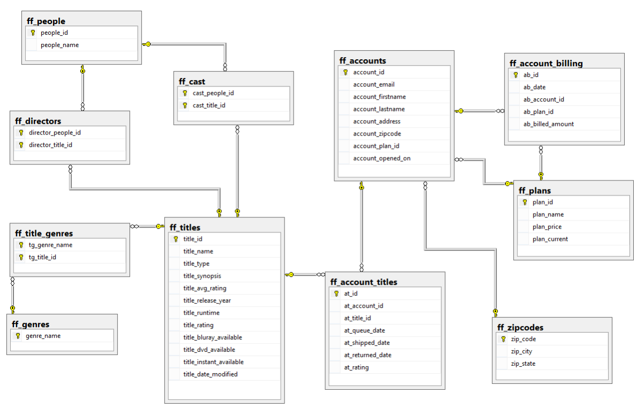
Goal:
Merge Fudgemarts Data into one data warehouse and evaluate our Fact.

Slide 3
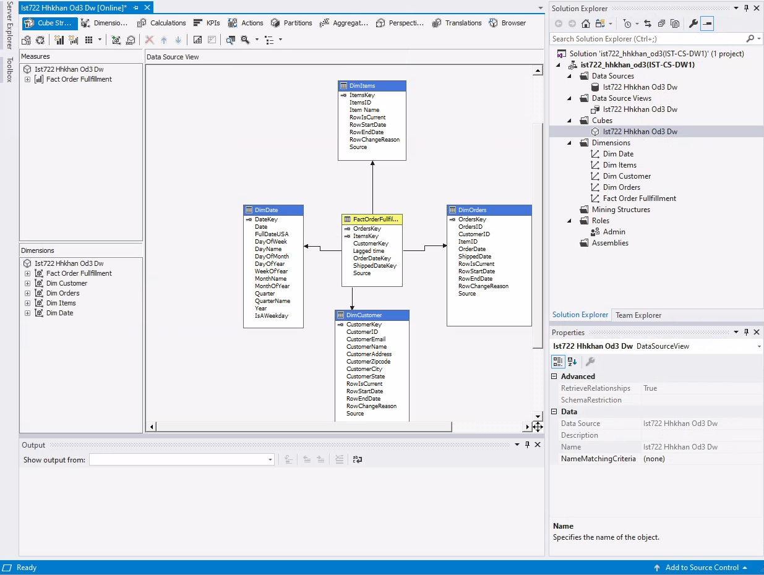
Assumptions
Star Schema
Account = Customer
Queue Date = Order Date
Account titles orders = orders
Title = Product =Items

Slide 4
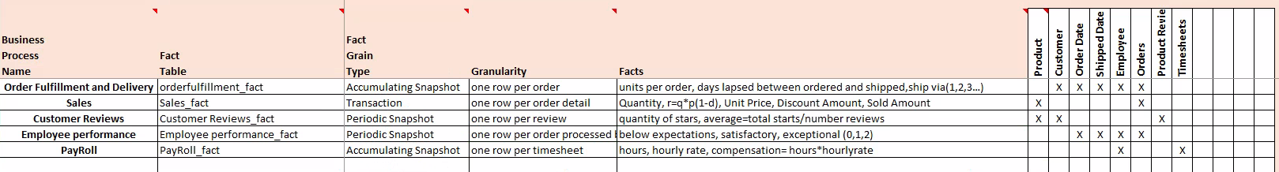
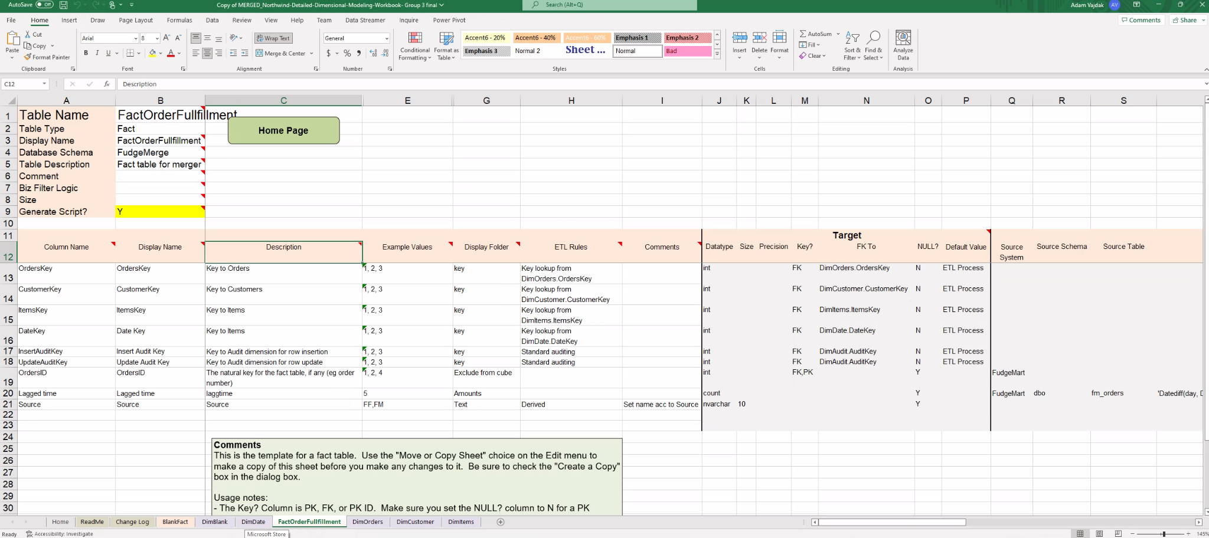
High Level To Detailed

Slide 5
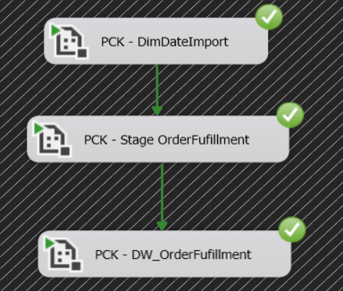
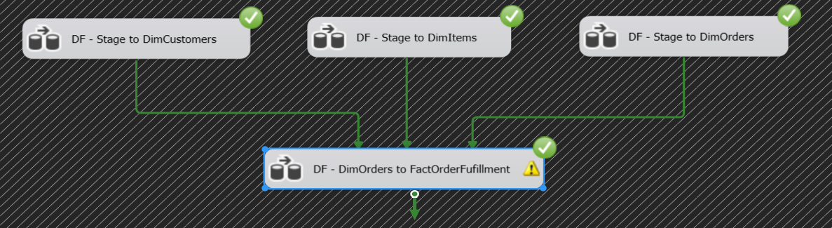
ETL Process

Slide 6
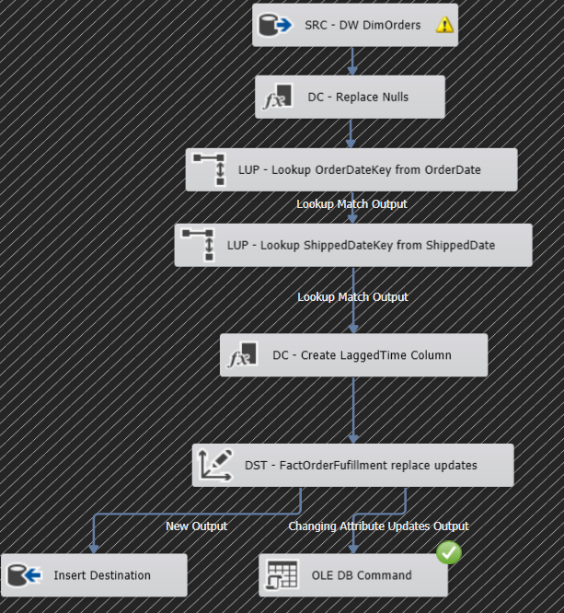
ETL Process (Cont’d)

Slide 7
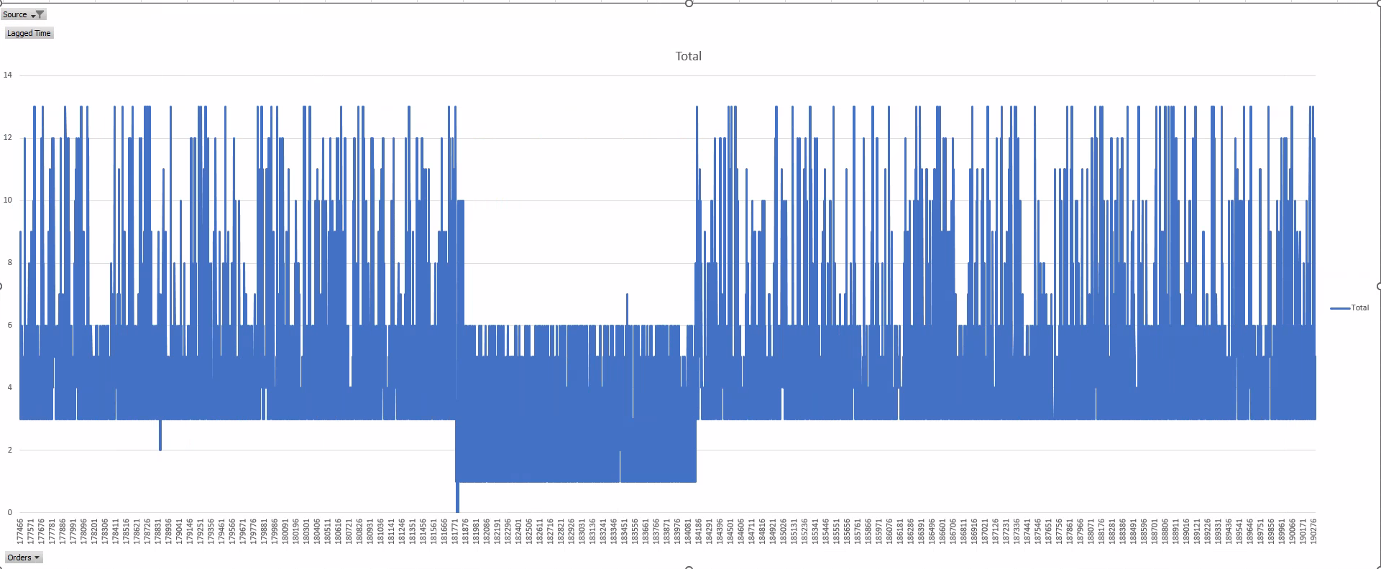
Lag Time Across Merger

Slide 8
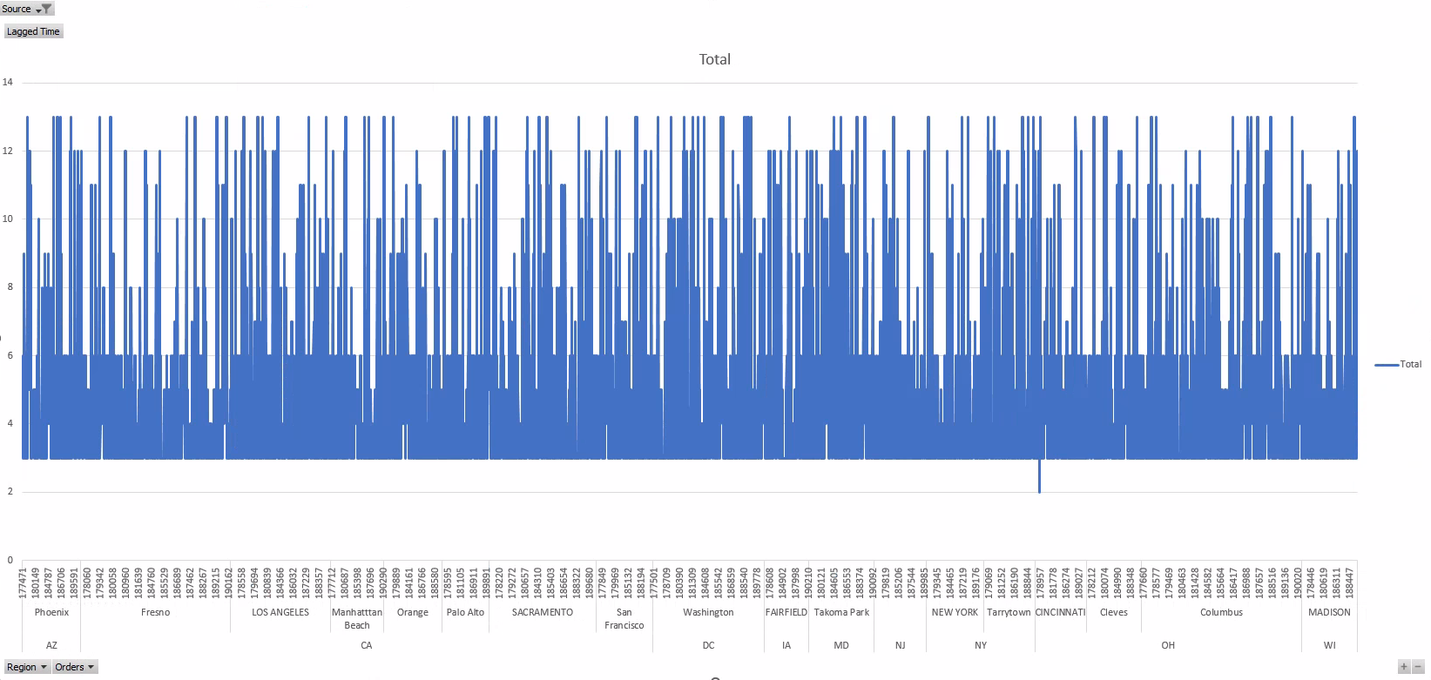
Lag Time By Region FM

Slide 9
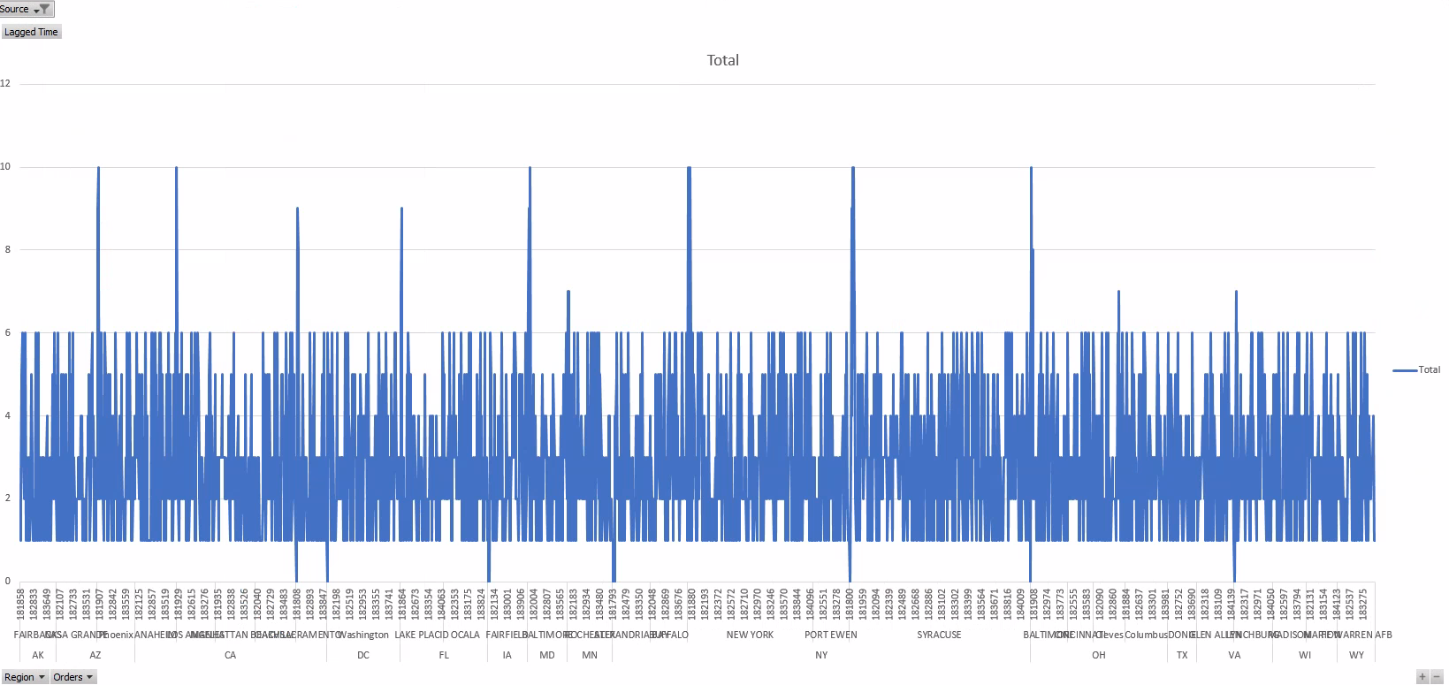
Lag time by region FF

Slide 10
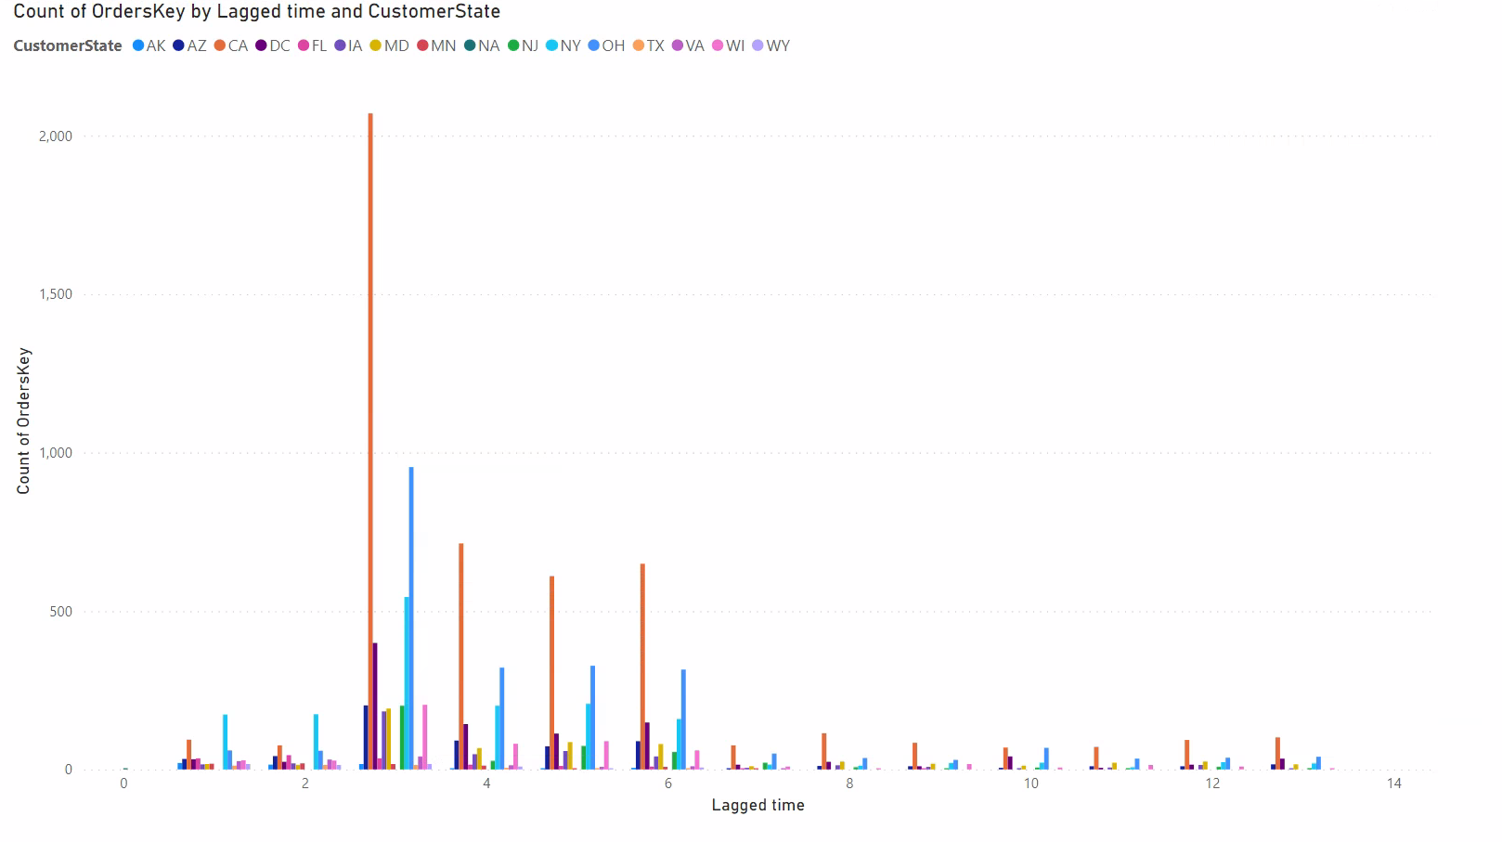

Slide 11
Recommendations
Work on reducing Lag time in FudgeMart over Fudge Flix.
Might have something to do with different business models affecting lag time.
No specific location has a bigger lag time then other states.

Slide 12
Nice to have data-
Wanting more information about shippers.
Titles where not shipped together.

